Slide 1
Predicting Loan Approval:
Binary Classification of Financial Risk Dataset
Oliver Butterworth-Bakhshi

Slide 2
Executive Summary
Summary of findings
Objective: Use ML models to predict loan classification from a Financial Risk dataset.
Use case: ML model can reduce the number of false positives (based on specificity), saving the bank millions of pounds in customer mortgage defaults that would otherwise be avoided.
Data Summary:
(Before processing): 20000 rows, 36 columns. (After cleaning and pre-processing): 5452 rows, 42 columns.
Target variable: y, Loan Approval, 1 for approved, 0 for rejected.
Key preprocessing steps: Removal of outliers, Drop irrelevant columns, Train-test split, Transform and scale categorical columns using Transformer, get.dummies() and StandardScaler.
Modelling and results:
Models used: kNN, SVC, Decision Tree, Bagging, Pasting, Random Forest, XGBoost, lightgbm.
Evaluation metrics: Precision, Accuracy, Recall, Specificity, with a focus on precision and specificity to maximise business benefit financially.
Findings: Best performing model overall = SVC. All models (apart from kNN) had over 0.96 in all metrics scored, very good fitting of data to model.
Key Insights: EDA highlighted that higher educated applicants were more likely to be successful. Feature importance and SHAP analysis highlighted key predictors of loan approval as RiskScore, Annual Income and Total DTI.
Recommendations and further study:
Recommendations:
Use best predictive SVC model to implement classification of loan applications.
Further study:
Use local SHAP analysis of best performing model to further validate conclusions.
Either improve the performance of feature-compatible models, or find a way to show feature analysis for the best performing SVC model.
Estimate business impact for a single bank: request and use a company dataset in a similar manner to this study.

Slide 3
Introduction
Background, Motivation, why data-driven approach?
“Lenders view loan approval from a risk management standpoint”. https://fastercapital.com/topics/understanding-the-importance-of-loan-approval.html
By carefully assessing each applicant's creditworthiness, lenders minimise the chances of default.
When a customer defaults on their loan, Banks typically lose 30-50% of the total loan amount. Average mortgage is 200K in the UK. Default rate is 5%.
Predictive models could save banks millions. Hence banking sector needs a data-driven analysis to better assess customer creditworthiness.

Slide 4
Method
Data pre-processing
Datasets from Kaggle: https://www.kaggle.com/datasets/lorenzozoppelletto/financial-risk-for-loan-approval, https://www.kaggle.com/datasets/taweilo/loan-approval-classification-data. I chose to focus solely on the Financial Risk dataset as it had a greater depth of columns to choose from.
Dropped columns: UtilityBillsPaymentHistory, BankruptcyHistory, PreviousLoanDefaults - these columns were irrelevant to my analysis.
Dropped column - MonthlyIncome. This column was very similar in correlation to Annual Income so to get greater contrast in the model, I removed MonthlyIncome rather than have both columns.
Outliers - errors I saw in the dataset were removed:
Experience > 50 years
Loan duration > 40 years
Credit score < 430
Savings >> 100k and current account balances >> 50k.
Final Dataset size: x_train = (5452 rows, 42 columns), x_test = (1364 rows, 42 columns).
Used get_dummies on categorical columns, transformed data with OneHotEncoder and StandardScaler.

Slide 5
Method (cont.)
Choice of ML models
I used a broad range of ML models for classification analysis.
RandomForest, XGBoost, kNN, SVC, Pasting, Bagging, lightgbm, DecisionTree classifiers.
Approach: fit all the models and compare performance.
I used GridSearchCV and Bayesian Optimisation to find the optimal combination of hyper-parameters for each model.
Hyper-parameter scoring prioritised test precision, as the cost of false positives is high (banks who approve too many risky loans can lose a lot of money if the customer defaults).

Slide 6
EDA insights
Summary: Part 1
Loan approval rate = 27.58%. 7 in 10 loans are not approved.
Education is a key factor in getting approval for a loan:
The number of high school graduates is 33% for rejection, and 18% for approval.
The proportion of approved applicants increases with the level of higher education. Doctorates are most likely to be approved, followed by Masters and then Bachelor applicants.
Annual Income: high annual income correlates with loan approval.
All applicants with >200k yearly salary were successful in getting a loan.
>100k, 85.63% were approved for a loan.
<100k, 80.68% were not approved for a loan.

Slide 7
EDA insights
Summary: Part 2
Self employed more likely to have their loan approved than employed/unemployed.
Loan amount/Monthly Loan Payment: Applicants asking for a higher loan amount and who would be paying off a large amount of debt monthly on a proposed loan are more likely to be rejected, as the lender views them as a high risk investment. Below a proposed monthly loan payment of 1k, 38% of applicants were successful in getting a loan. Above 2k: 90.10% of applicants were rejected for a loan.
TotalDTI: Low DTI combined with high annual income leads to loan approval. mean|Total DTI| = 0.139 with an annual income of 115k+, 90% of loans were approved.

Slide 8
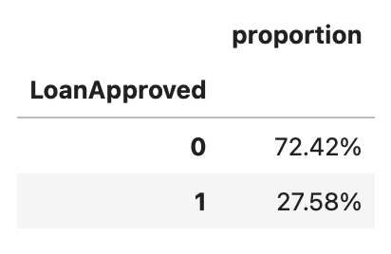
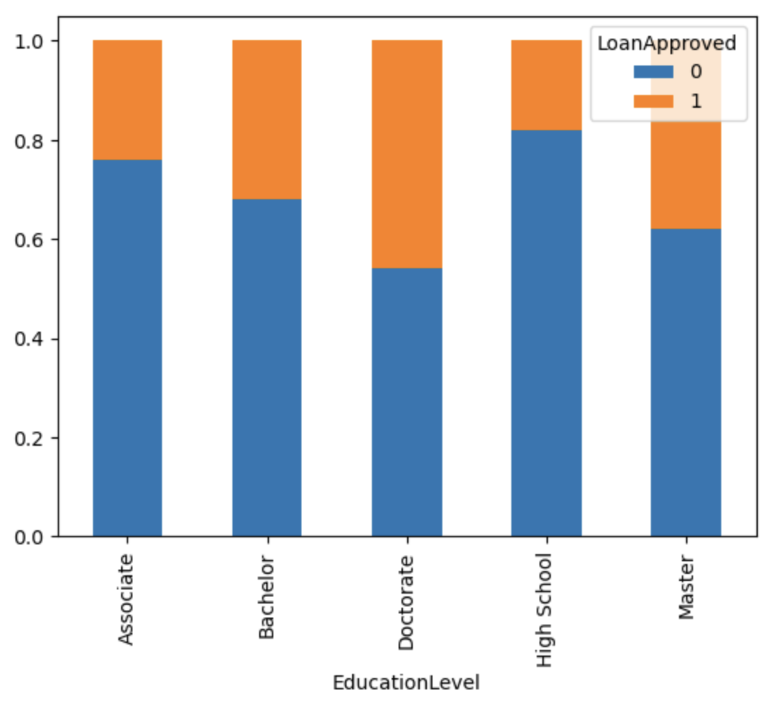
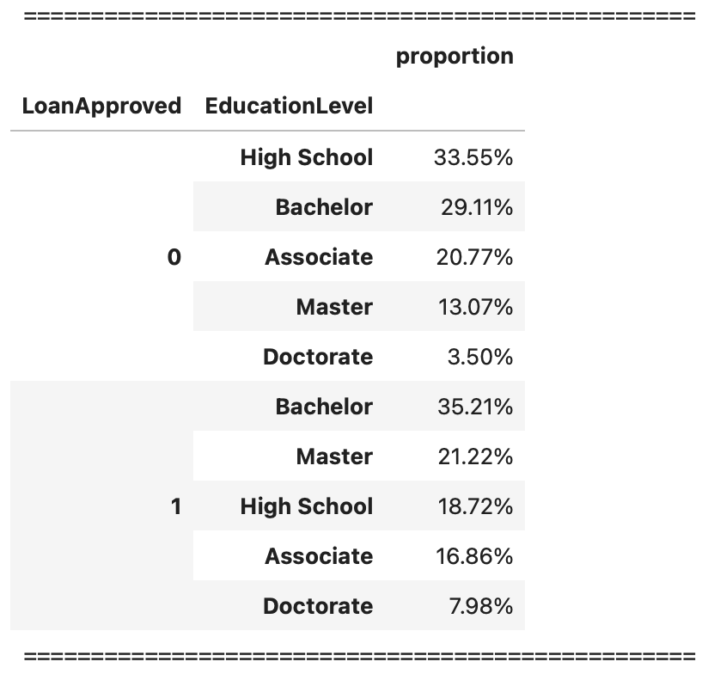
EDA insights
Graphical Summary: Part 1
Loan approval rate = 27.58%
Doctorates are most likely to be approved, followed by Masters and then Bachelor applicants.

Slide 9
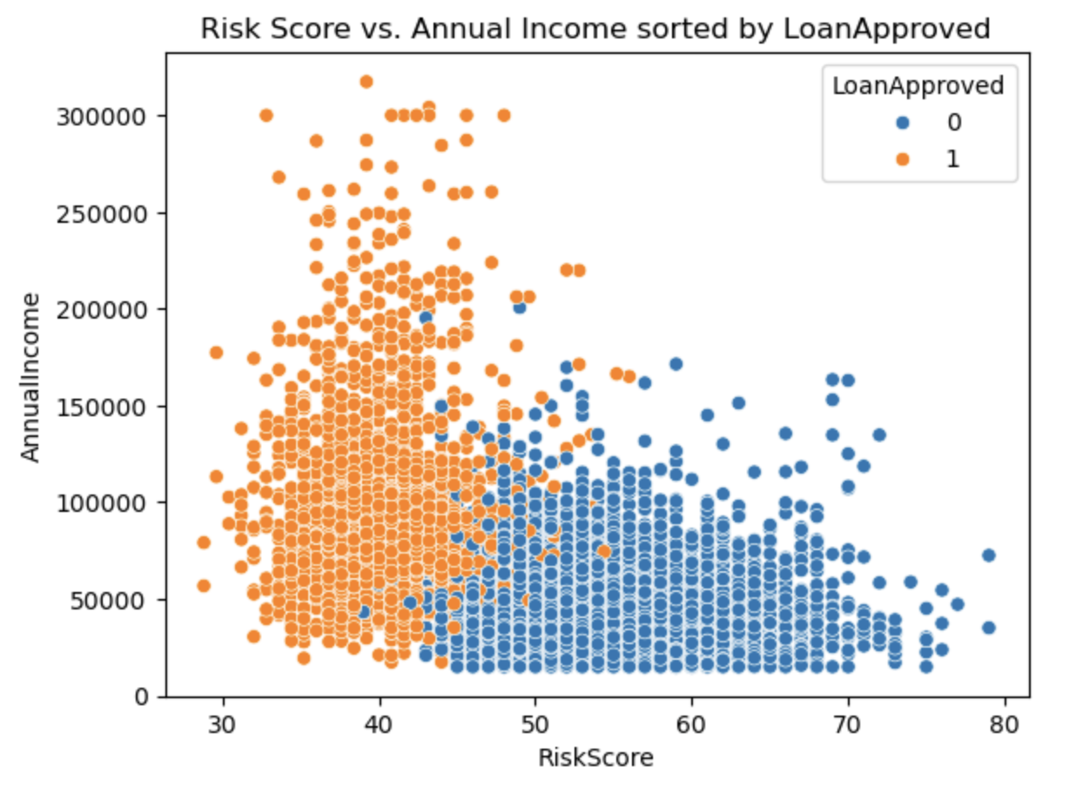
EDA insights
Graphical Summary: Part 2
All applicants with >200k yearly salary were successful in getting a loan.
>100k, 85.63% were approved for a loan.
<100k, 80.68% were not approved for a loan.

Slide 10
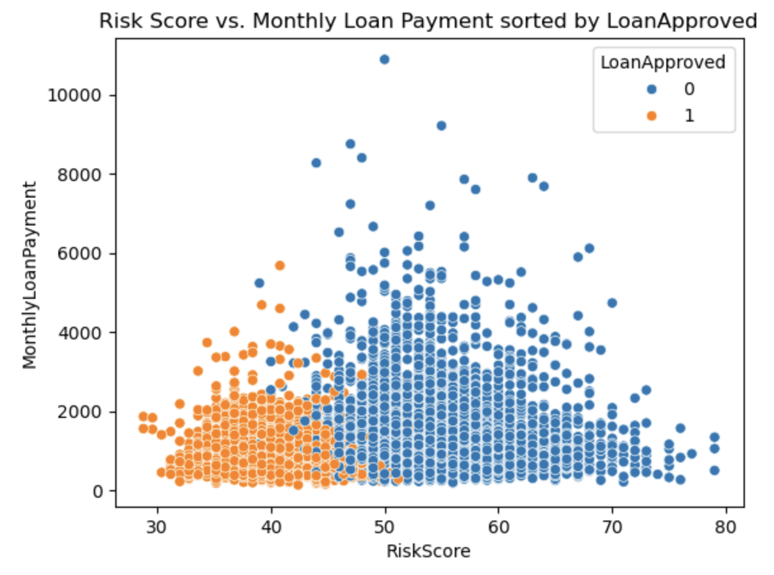
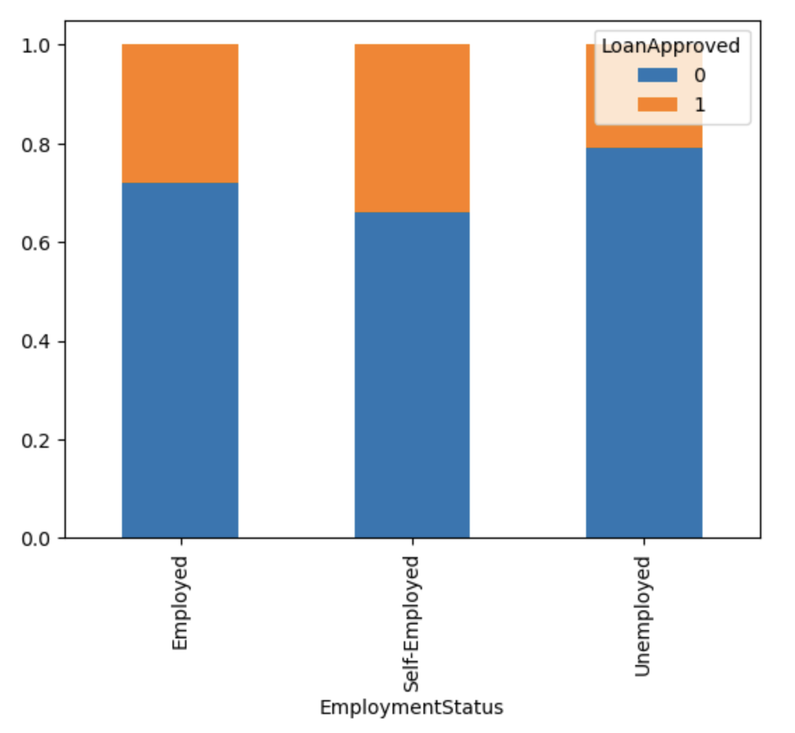
EDA insights
Graphical Summary: Part 3
Below a proposed monthly loan payment of 1k, 38% of applicants were successful in getting a loan.
1-2k: 80.60% of applicants were rejected for a loan.
Above 2k: 90.10% of applicants were rejected for a loan.
Self employed proportionally more likely to have their loan approved than employed/unemployed.

Slide 11
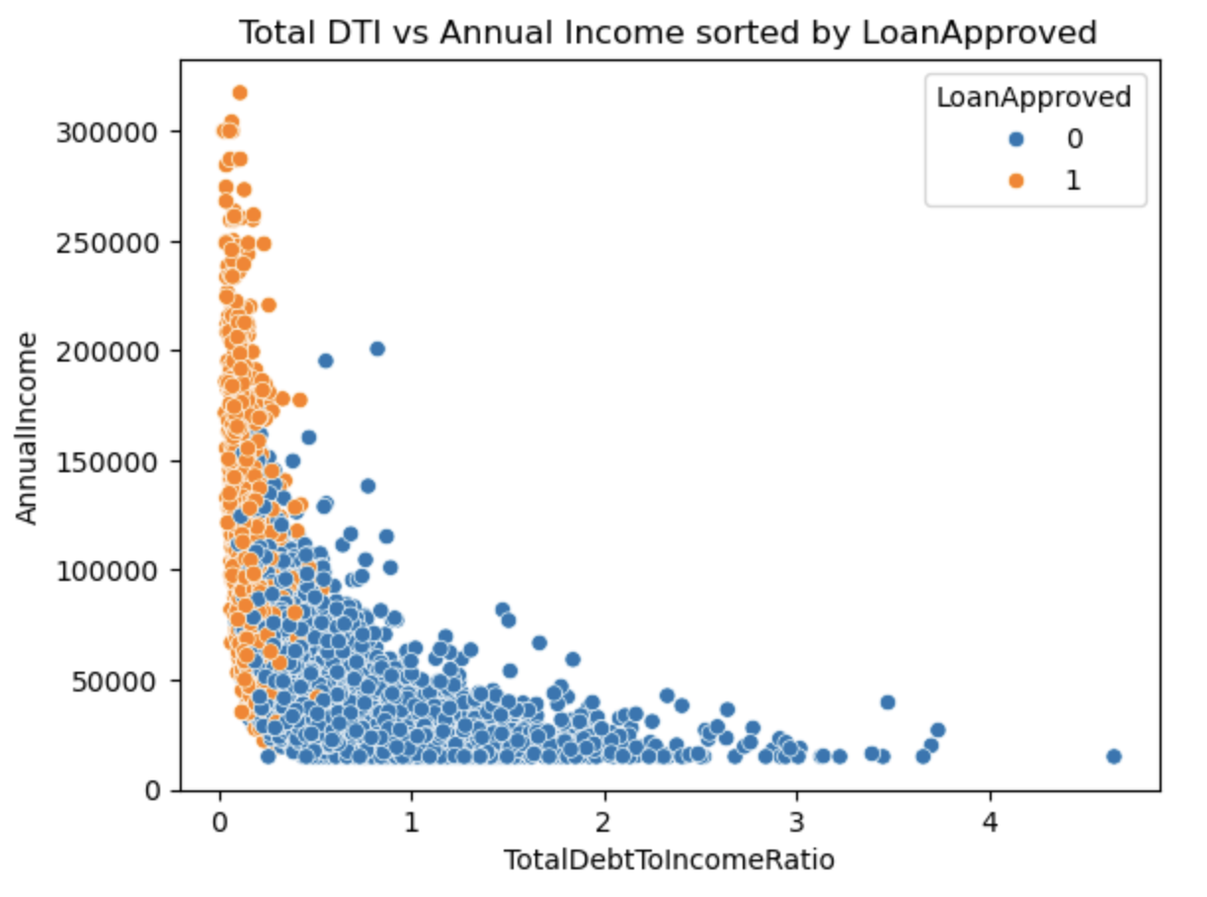
EDA insights
Graphical Summary: Part 4
All applicants with >200k yearly salary were successful in getting a loan.
mean|Total DTI| = 0.139 with an annual income of 115k+, 90% of loans were approved.
mean|Total DTI| = 0.139

Slide 12
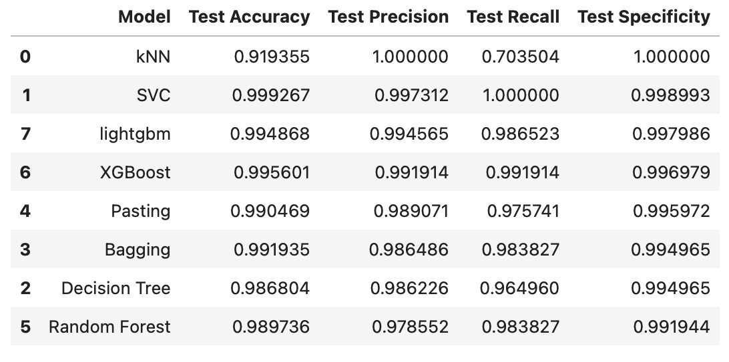
Modelling Results
Performance Evaluation: Table
Models sorted by test precision.
Most precise model: kNN
Most accurate model: SVC
Best performing model overall: SVC

Slide 13
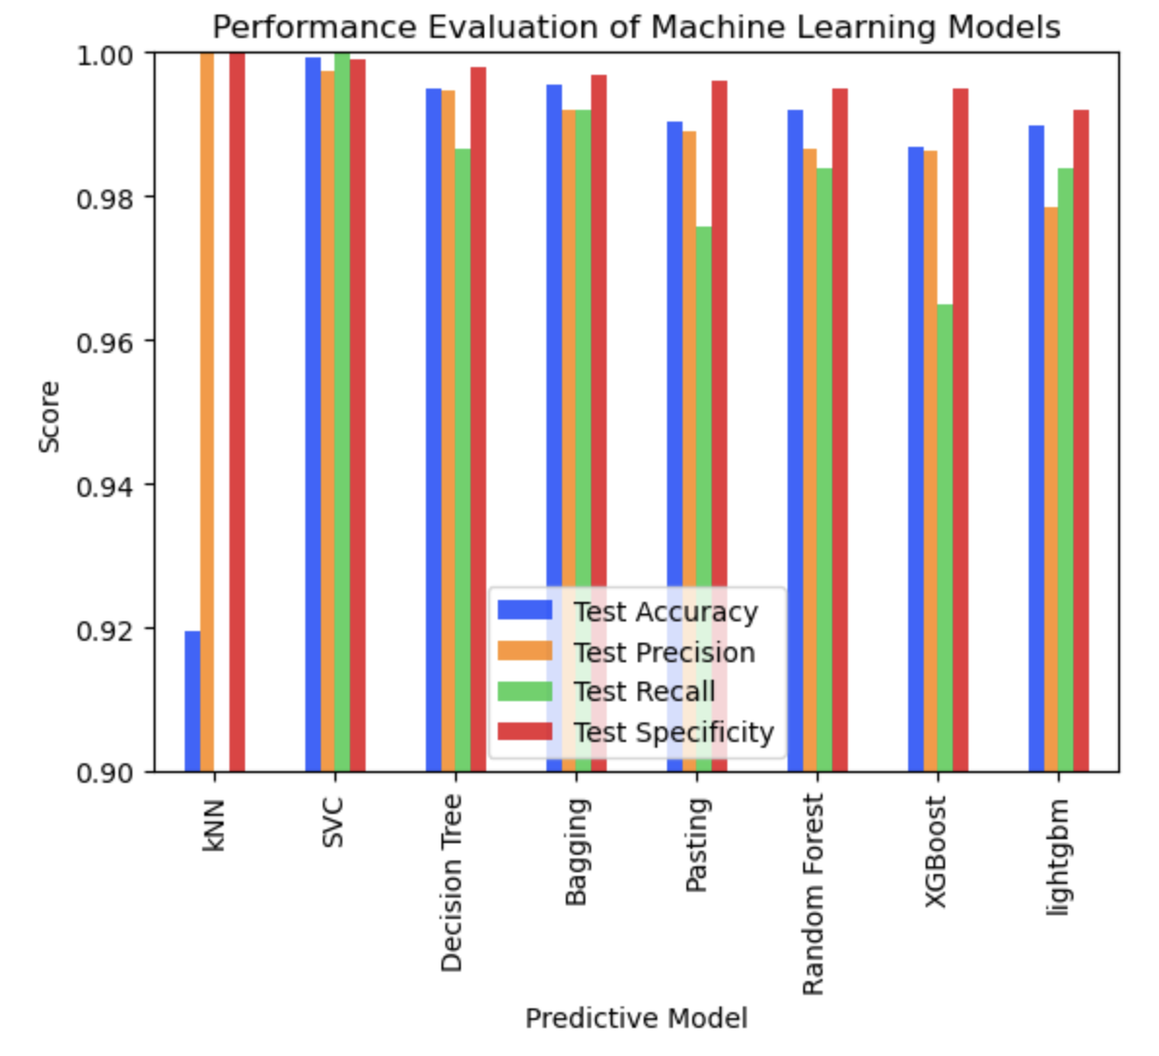
Modelling Results
Performance Evaluation: Graphical Comparison
kNN precise but less accurate.
SVC strong all round performance
Apart from kNN, none of the models dropped below 0.96 - very well fitted models and strong classification performance.
Validates feature importances in next slides

Slide 14
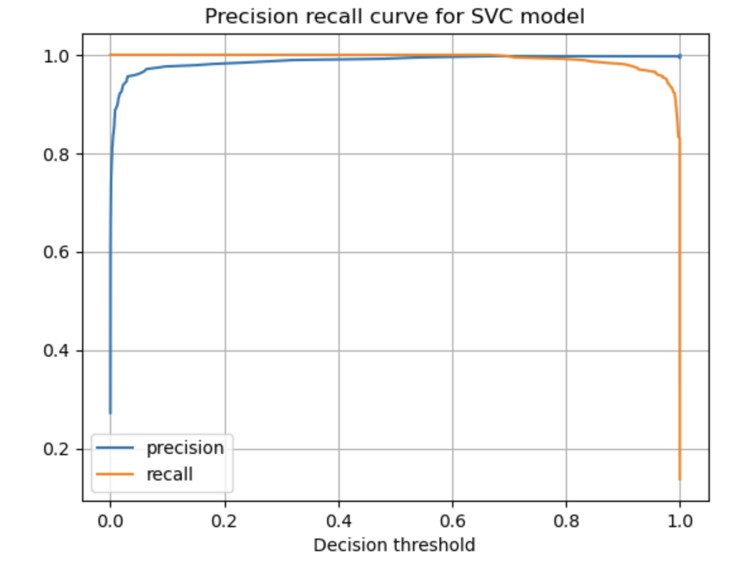
Modelling Results
PR curve for overall best performing SVC model
Very sharply defined decision threshold.
AUC (Area under curve) is approximately 1 (or very close to 1).
This suggests an optimal, near-perfect fit.
Performance in classification is very high, near 100%.

Slide 15
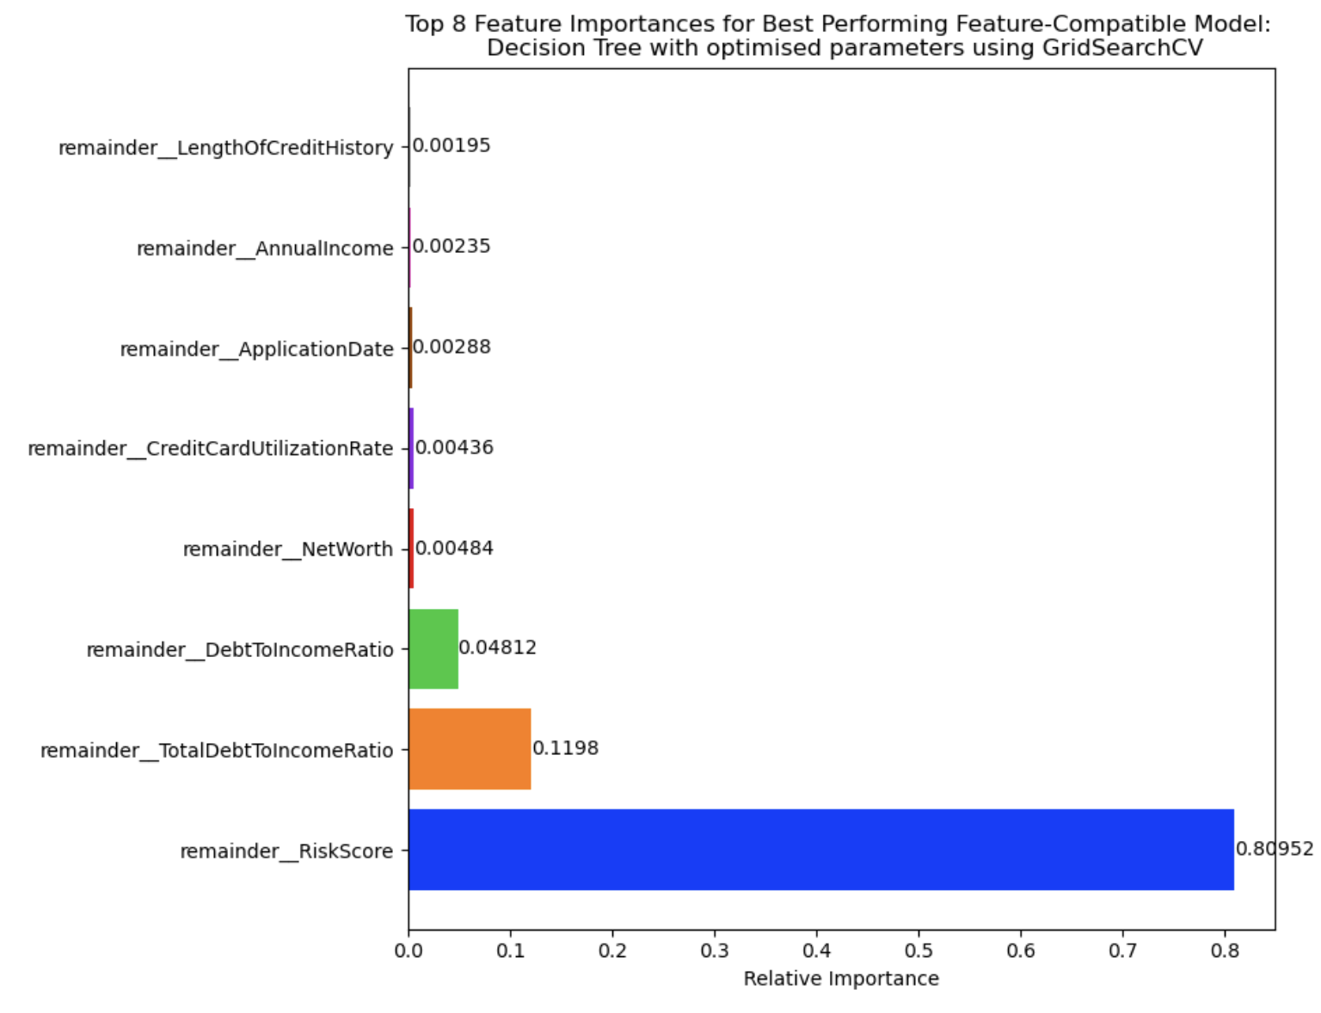
Modelling Results
Feature importances: Decision Tree model
Risk score overwhelming indicator of whether loan is approved.
Other major factors include TotalDTI, DTI, Net Worth
Lower income applicants with large debt payments have higher risk scores and are more likely to be rejected for a loan.

Slide 16
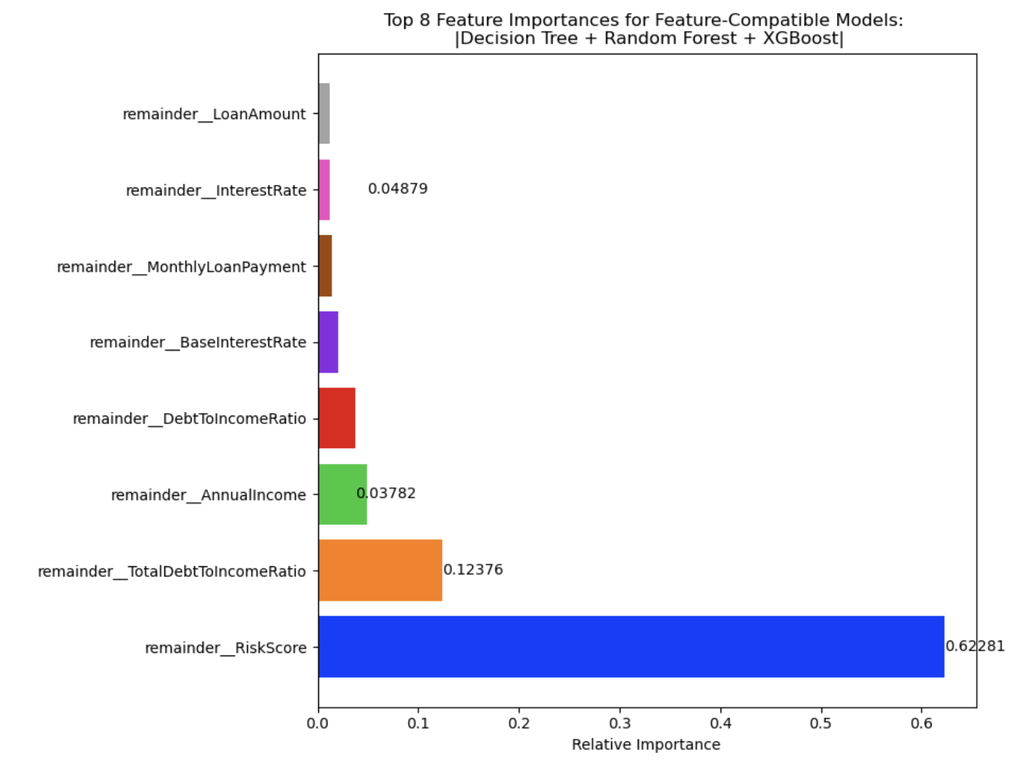
Modelling Results
Feature importances: |DT + RF + XGBoost|
Risk score biggest factor again.
TotalDTI, Annual Income and DTI key factors in predicting loan approval.
This matches the conclusions found in EDA: Higher incomes, lower debts, lower risk score -> loan more likely to be approved.

Slide 17
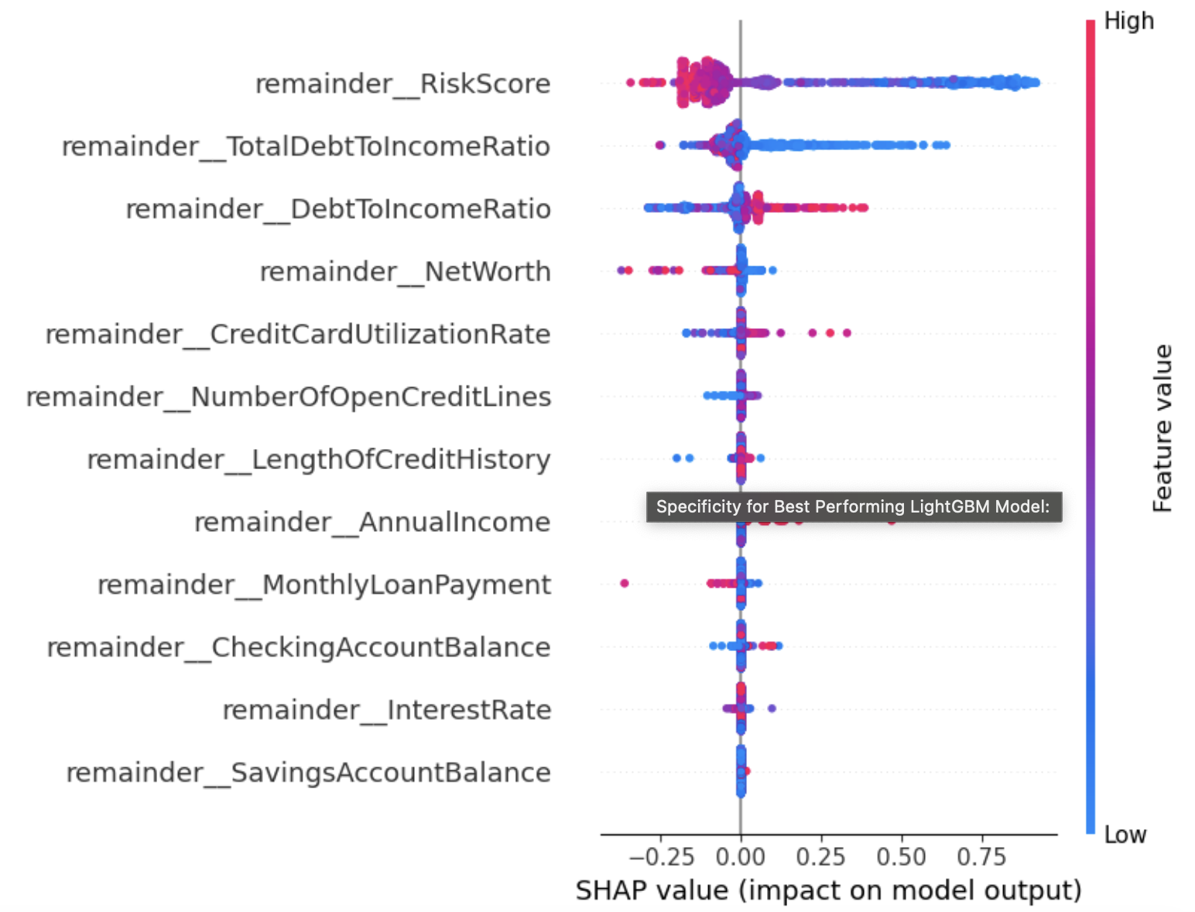
Modelling Results
SHAP analysis: Decision Tree model: Part 1
High risk score: SHAP value is negative: Risk score predicts loan rejection. Most cases have a high risk score and are rejected (see dense red area in bee-swarm).
Low TotalDTI: SHAP value is positive, Low TotalDTI predicts loan approval. Large spread of cases have low TotalDTI and are approved (see long blue area in bee-swarm).

Slide 18
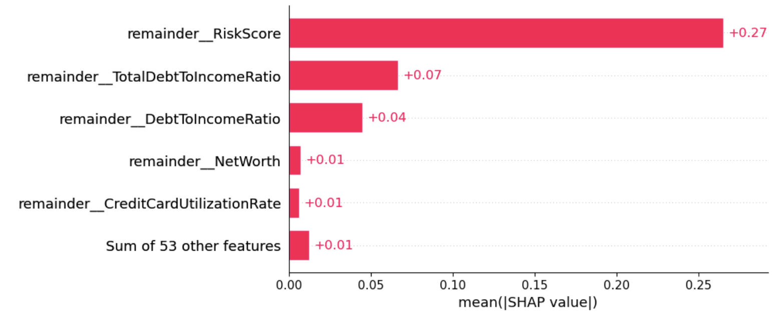
Modelling Results
SHAP analysis: Decision Tree model: Part 2
Biggest global factors that contribute to loan approval are Risk Score, TotalDTI, Net Worth.
This matches the model-specific feature importance from earlier
High debt, low income applicants seen as too risky to offer a loan and are thus rejected.

Slide 19
Business Impact
How much could the UK banking industry save annually?
I created a mobile Streamlit app which can be used to calculate the annual savings to the UK banking sector using the precision specificity of a predictive ML model (like the ones in this study).
Annual saving is approx £961 million with best model compared to not using a predictive model to classify loan applications.
Based on average UK mortgage size in 2024, number of mortgages approved in Q1 of 2024 and average annual mortgage default rate.
Link: https://mobileloancostapp-q4a9vpsebx2vffwlnly5dr.streamlit.app

Slide 20
Conclusions
Overall summary
Key factors in predicting and classifying Loan Approval:
Risk Score: High risk score guarantees loan rejection.
Education: higher postgraduate educated applicants are more likely to be approved for a loan than undergraduates and high schoolers.
Annual Income: higher income applicants are very likely to be approved a loan and seen as low risk.
Size of loan: asking for a smaller loan and monthly loan repayments is seen as low risk and means you are more likely to be approved.
Debt-to-income ratio: having lower debt proportional to your income is seen as low risk and means higher chance of approval.

Slide 21
Next steps
Areas for improvement and further study
Recommendations:
Use best predictive SVC model to implement classification of loan applications.
Further study:
Use local SHAP analysis of best performing model to further validate conclusions (e.g. on RiskScore, Annual Income, etc).
Either improve the performance of feature-compatible models, or find a way to show feature analysis for the best performing SVC model.
Estimate business impact for a single bank: request and use a company dataset in a similar manner to this study.

Slide 22
Appendix
Extra bits
Hyperparameters for best performing models:
kNN: (n_neighbors=101, algorithm = 'auto', weight = ‘uniform’).
SVC: (degree=2, kernel='poly', probability=True, random_state = 22).
Decision Tree: (ccp_alpha=0, criterion='entropy', max_depth=6, random_state=22).
Bagging: (DecisionTreeClassifier(max_depth=6), n_estimators=100, random_state = 22).
Pasting: BaggingClassifier(bootstrap=False, estimator=DecisionTreeClassifier(max_depth=8), n_estimators=50,random_state=22).
Random Forest: (ccp_alpha = 0, criterion = 'gini', max_depth = 12, min_samples_split = 3, n_estimators = 100, random_state = 22).
XGBoost: (ccp_alpha = 0, criterion = log_loss, max_depth = 17, min_samples_split = 2, random_state = 22).
Lightgbm does not take any hyper parameters

